Slide 1

Application Layer Protocols
and
Services -4
Delivered By:
Avinash Bhagat
9463281930
avinash.bhagat@lpu.co.in
Copyright © The McGraw-Hill Companies, Inc. Permission required for reproduction or display.

Slide 2
Domain Name System (DNS) Chapter 25
TELNET Chapter 26
Simple Mail Transfer Protocol and Post Office Protocol Chapter 26
File Transfer Protocol Chapter 26
World Wide Web www Chapter27
Hyper text transfer Protocol HTTP Chapter27
Terminologies in Network Security Chapter30
Firewalls Chapter32
Virtual Private Network (VPN) Chapter32

Slide 3
The World Wide Web (WWW) is a repository of information linked together from points all over the world.
The WWW has a unique combination of flexibility, portability, and user-friendly features that distinguish it from other services provided by the Internet.
Copyright © The McGraw-Hill Companies, Inc. Permission required for reproduction or display.

Slide 4
The WWW project was initiated by CERN Conseil Européen pour la Recherche Nucléaire (European Laboratory for Particle Physics)
to create a system to handle distributed resources necessary for scientific research.
Copyright © The McGraw-Hill Companies, Inc. Permission required for reproduction or display.

Slide 5
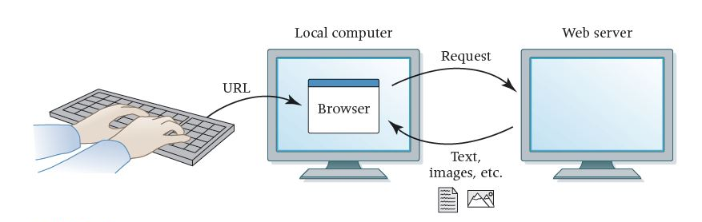
World Wide Web (www)
Website A collection of related web pages
Web browser A software tool that retrieves and displays web pages
Web server A computer set up to respond to requests for web pages
Uniform Resource Locator (URL) A standard way of specifying the location of a Web page, containing the hostname, "/", and a file

Slide 6

Architecture of WWW
The WWW today is a distributed client/server service, in which a client using a browser can access a service using a server. However, the service provided is distributed over many locations called sites.

Slide 7
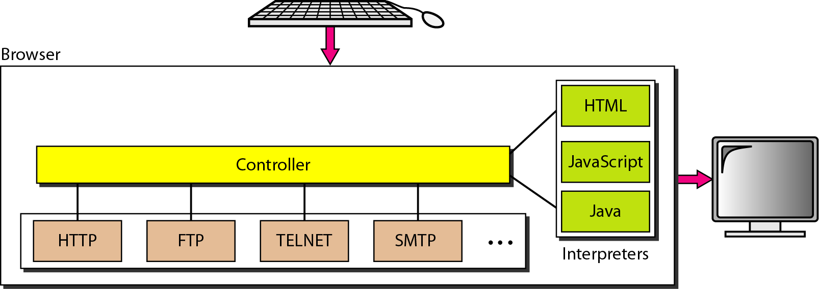
Client (Browser)
Each browser usually consists of three parts: a controller,
client protocol, and interpreters.
The controller receives input from the keyboard or the mouse and uses the client protocols to access the document.
After the document has been accessed, the controller uses one of the interpreters to display the document on the screen.

Slide 8
Server:
The Web page is stored at the server. Each time a client request arrives, the corresponding document is sent to the client.
  To improve efficiency, servers normally store requested files in a cache in memory; memory is faster to access than disk.
  A server can also become more efficient through multithreading or multiprocessing. In this case, a server can answer more than one request at a time.

Slide 9

Uniform Resource Locator
a URI is defined as any character string that identifies a resource
https://www.ibm.com/support/knowledgecenter/en/SSGMCP_5.1.0/com.ibm.cics.ts.internet.doc/topics/dfhtl_uricomp.html
https://mail.google.com/mail/u/0/#inbox

Slide 10
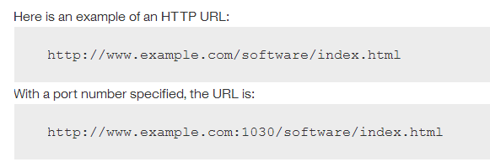
Uniform Resource Locator

Slide 11
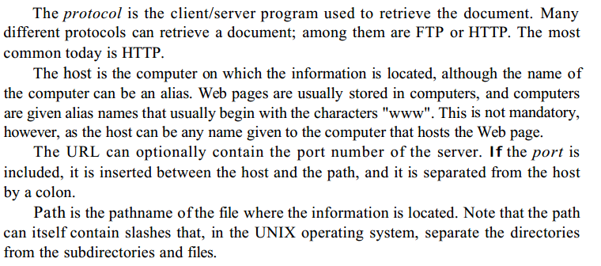

Slide 12
Hypertext Transfer Protocol (HTTP)
The Hypertext Transfer Protocol (HTTP) is a protocol used mainly to access data on the World Wide Web. HTTP functions as a combination of FTP and SMTP.
HTTP uses the services of TCP on well-known port 80.

Slide 13
Hypertext Transfer Protocol (HTTP)
HTTP Vs FTP
It is similar to FTP because it transfers files and uses the services of TCP. However, it is much simpler than FTP because it uses only one TCP connection.
There is no separate control connection; only data are transferred between the client and the server.

Slide 14
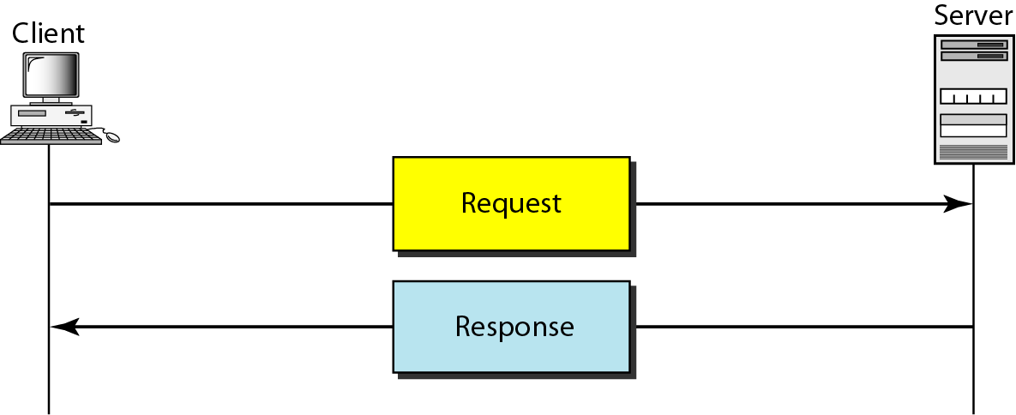
HTTP Transaction
HTTP uses the services of TCP, however HTTP itself is a stateless protocol. The client initializes the transaction by sending a request message. The server replies by sending a response.

Slide 15
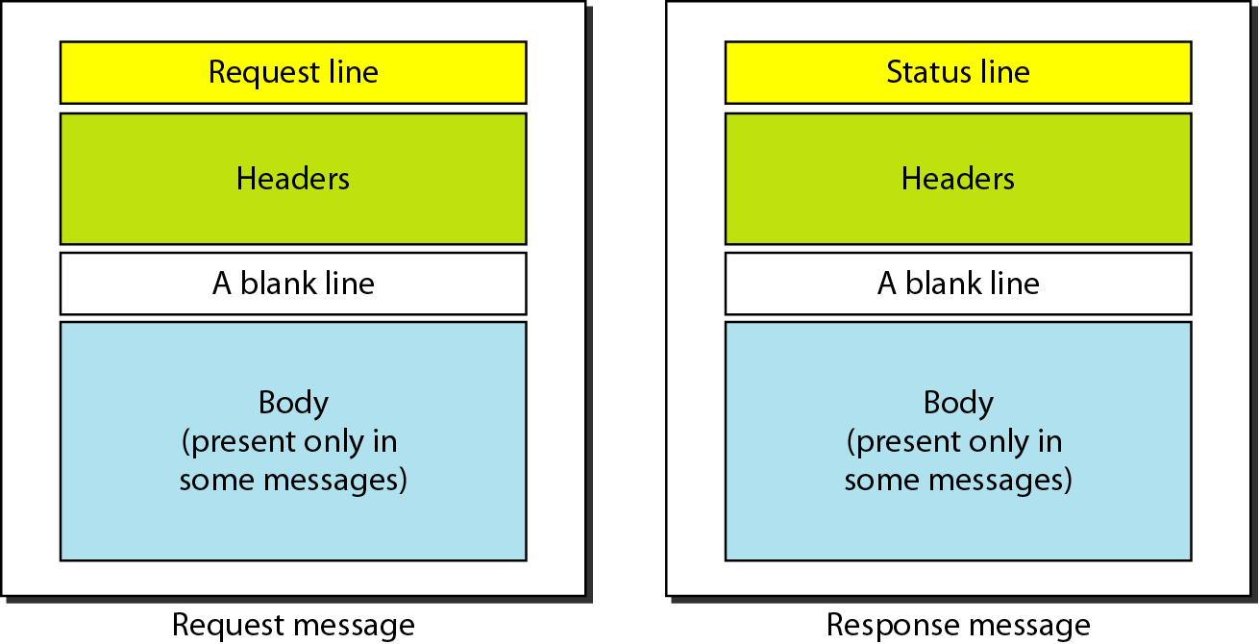
Messages in HTTP
A request message consists of a request line, a header, and sometimes a body.
A response message consists of a status line, a header, and sometimes a body.

Slide 16
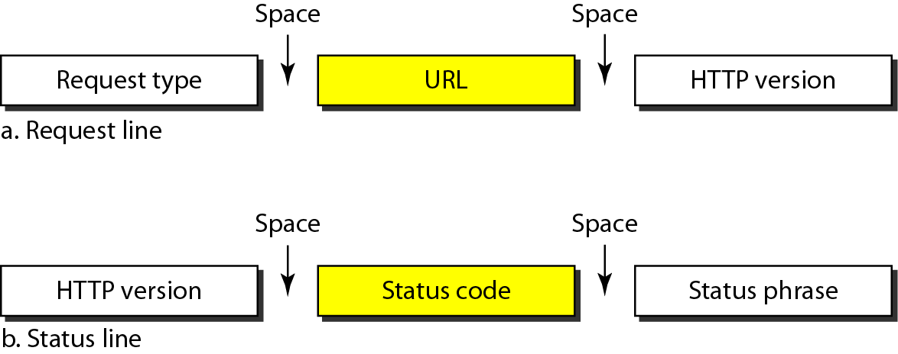
Request and Status Lines: The first line in a request message is called a request line; the first line in the response message is called the status line.

Slide 17
Subjective questions
Write a note on
WWW
HTTP

Slide 18
Multiple Choice questions:
_________ is a repository of information linked together from points all over the world.
a. The WWW
b. HTTP
c. HTML
d. FTP

Slide 19
Multiple Choice questions:
_________ is a repository of information linked together from points all over the world.
a. The WWW
b. HTTP
c. HTML
d. FTP

Slide 20
Multiple Choice questions:
The WWW today is a _______ client-server service, in which a client using a browser can access a service using a server.
a. limited
b. vast
c. distributed
d. stand alone

Slide 21
Multiple Choice questions:
The WWW today is a _______ client-server service, in which a client using a browser can access a service using a server.
a. limited
b. vast
c. distributed
d. stand alone

Slide 22
Multiple Choice questions:
The _________ is a standard for specifying any kind of information on the Internet.
a. URL
b. ULR
c. RLU
d. html

Slide 23
Multiple Choice questions:
The _________ is a standard for specifying any kind of information on the Internet.
a. URL
b. ULR
c. RLU
d. html

Slide 24
Multiple Choice questions:
In a URL, the _______ is the client-server program used to retrieve the document.
a. path
b. protocol
c. host
d. none of the above

Slide 25
Multiple Choice questions:
In a URL, the _______ is the client-server program used to retrieve the document.
a. path
b. protocol
c. host
d. none of the above

Slide 26
Multiple Choice questions:
In a URL, the ______ is the computer on which the information is located.
a. path
b. protocol
c. host
d. none of the above

Slide 27
Multiple Choice questions:
In a URL, the ______ is the computer on which the information is located.
a. path
b. protocol
c. host
d. none of the above

Slide 28
Multiple Choice questions:
In a URL, the _______ is the full name of the file where the information is located.
a. path
b. protocol
c. host
d. none of the above

Slide 29
Multiple Choice questions:
In a URL, the _______ is the full name of the file where the information is located.
a. path
b. protocol
c. host
d. none of the above

Slide 30
Multiple Choice questions:
HTTP uses the services of _________ on well-known port 80.
a. UDP
b. IP
c. TCP
d. FTP

Slide 31
Multiple Choice questions:
HTTP uses the services of _________ on well-known port 80.
a. UDP
b. IP
c. TCP
d. FTP

